Slide 1
Twin Towers
Home Owners Association
A Year In Review

Slide 2

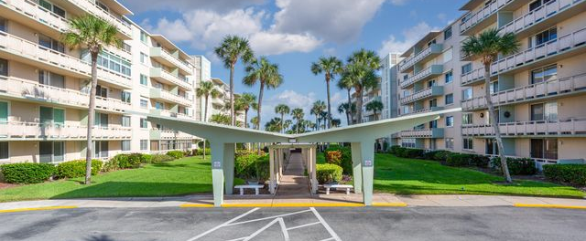




2024 - 2025 Board Members
Lane Ramsfield – President
Dennis Howden Vice President
Tom Bowe – Treasurer
Kelly Stanton – Secretary

Slide 3
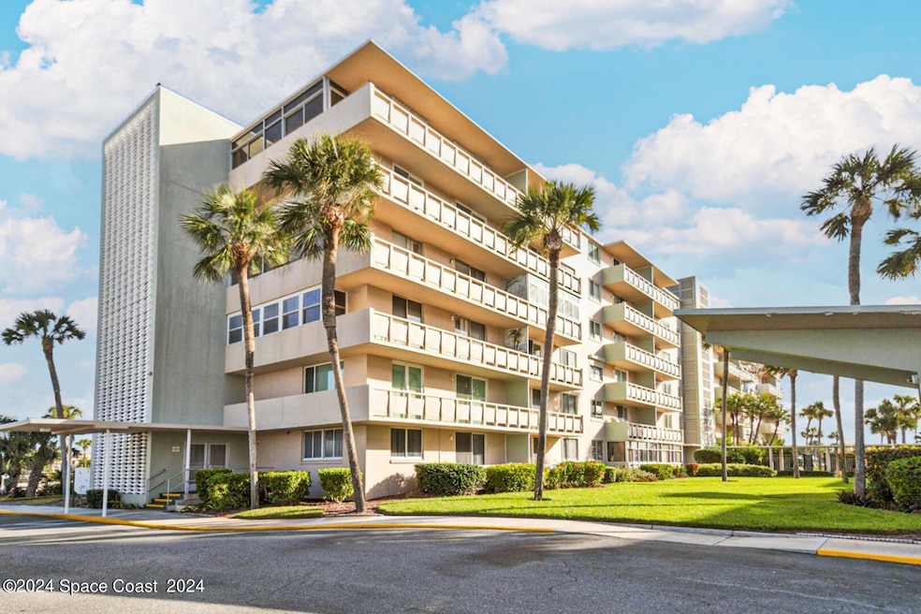
Capital Improvements that have been completed this year:
Crack Repairs on all sides of the N & S building’s exterior walls
Utilized American Concrete Institute prescribed repair methods (routed out the cracks; squared around it; utilized Euclid chemical non-shrink admix in the concrete patch)
Sidewalks - removed and replaced with 4000 psi Concrete with Integral Fibers, 6” thick:
Throughout the complex we repaired all of the service sidewalks. On both sides of the N & S Bldgs.
Around the Pool (including the low area, near the pool NE gate (which would constantly hold water)
Both Entrances to the Atlantic Room
All edges of the Sidewalks in the Parking areas were painted yellow.
Under the Carports – the sidewalks were recoated with a non-slip coating
Sidewalk staining and upgrades.

Slide 4
Capital Improvements that have been completed this year: Cont.
Replacement and repair of recreational area furniture
Landscaping and paving in shuffleboard courts.
Renovation of the Pickle Ball Courts, Surfacing and nets.
Landscaping renovations along North Atlantic Ave.
Final Concrete repair contract on the balconies
Dumpster Enclosure upgrade
Replacement of Kitchen Sanitary Sewer stacks
Repainting of the center corridor walls.
Unit 110 renovation and repair and rented with a one year lease agreement.
A/C Room Floor repairs

Slide 5
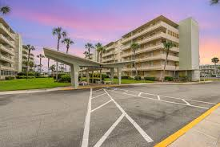
Capital Improvements that have been completed this year: Cont.
Service aprons in Both Buildings
Cameras in the parking lot
Camera upgrades in the elevator and building entrances.
New Roofs on both the south building and and Atlantic Room. This includes a 20 year labor and material warranty.
Inlet Culverts in the yards.
Damaged Catch Basins - were removed and repoured with 4000 psi Concrete with Integral Fibers, and #5 rebar, 6” thick
Carport concrete Columns and Beams – Repaired all cracks and utilized Euclid chemical admix in the concrete; painted the impacted areas.

Slide 6
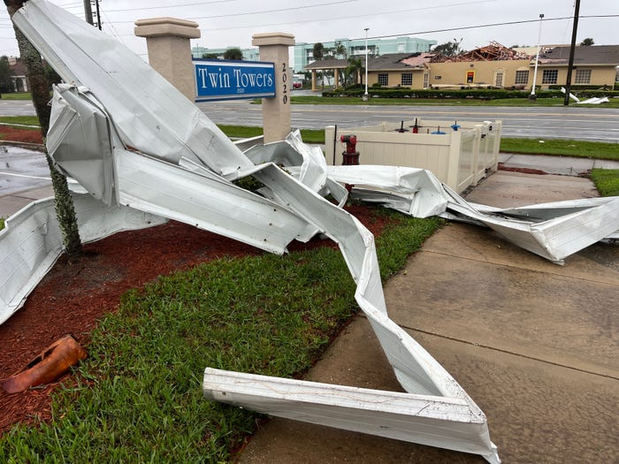
Parking Structure Accident & Tornado Damage:
The Damage included sever damage to the carport roofing panels, some misc. structural damage, landscaping damage, window damage, roofing damage, fence damage, well damage, balcony divider damage, etc.
We settled with the insurance company for approximately $897,000. The hit and run structural damage is an $80,000 repair cost.
Tore out the damaged Columns and Beam in the Parking lot South corner (due to a truck Backing into the structure); used 5000 psi, with HRWR, and #6 rebar and stirrups

Slide 7
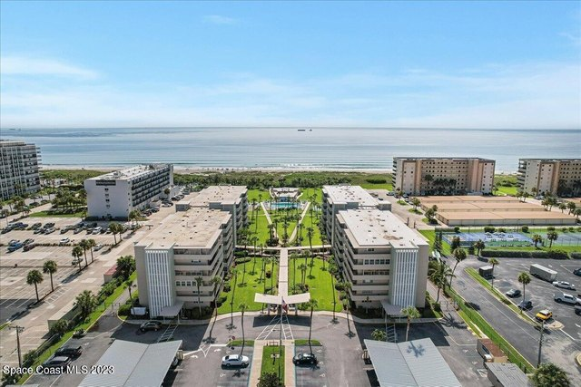
Reserve Studies & Milestone Inspection
(Senate Bill 4D requirements):
A Structural Integrity Reserve Study (SIRS Study) was required by the Senate Bill 4D
This has been completed in accordance with the required guidelines by Sedgwick Engineering
This is posted on our website.
We completed a non-SIRS Study of other long-term capital improvements
The studies reflect a required annual contribution of $275,000 for the next 40 years.
We have a fully funded reserve account one year earlier than is required by the state of Florida legislature. The reserves studies required a fund balance of $475,000 January 1, 2025

Slide 8
Financial Status:
We reduced the monthly fees by approximately 25% and have maintained the market comparable monthly fees for 2025
Current Financial Balance Status
Operating Accounts
Reserves Accounts –
Total Cash On Hand - $1,986,000
Encumbrances for future obligations and contracts
Reserve Study required Balance - $475,000
Out Standing Contract Obligations:
RL Davis Construction (Balcony repairs) - $609,000
Misc. Concrete Repair and contingency - $ 75,000
Keystone Construction Administration - $ 30,000
Contingency Reserve - $ 40,000
JP Laneuville Roofing - $150,000
CB Plumbing Riser replacement - $ 89,000
Hallway repair and repainting - $ 70,000
Total Encumbered Funds and Reserve Account Req. - $ 1,550,000
Projected Excess Operating and Reserve Cash : $436,000

